Slide 1
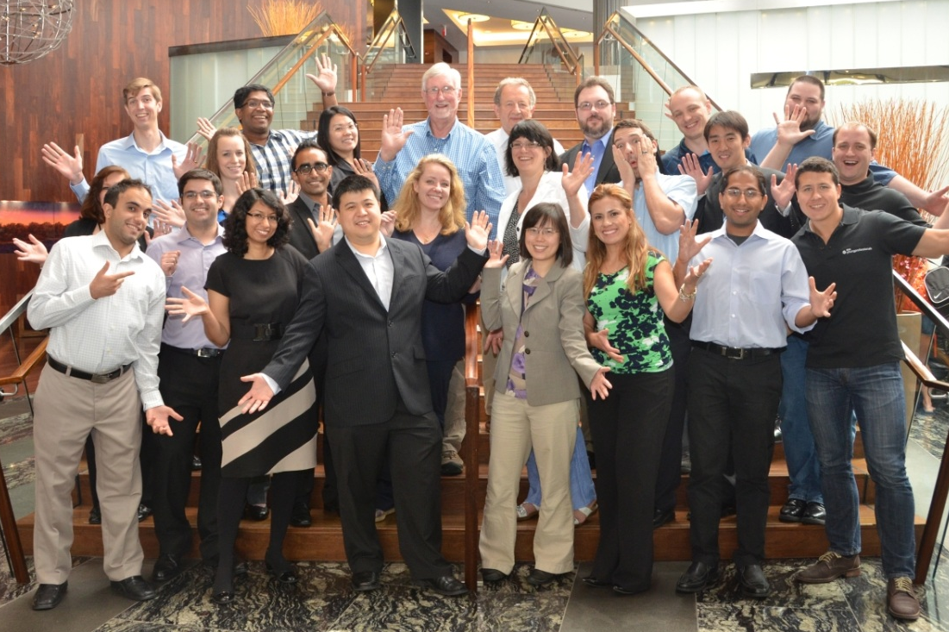
Transition from Student to Young Professional
Welcome to the next phase of your career!
IEEE Young Professionals London
www.facebook.com/pages/IEEE-Young-Professionals-London-Ontario
www.ieeeyp.com

Slide 2
IEEE World’s largest professional association for the advancement of technology for humanity
IEEE (Institute of Electrical & Electronics Engineers) is a professional organization, which provides the latest technical knowledge for its members
Conferences
Journals
Workshops
Continued Education
450,000 members worldwide, in more than 160 countries

Slide 3
Introducing IEEE Young Professionals
Caters to the professional development of recent graduates and early career professionals
Expose members and prospective members to new and unique career opportunities
Workshops
Seminars
Networking Events

Slide 4
Products & Services for Young Professionals Webinars

Slide 5
Products & Services for Young Professionals Career-Based Services
http://mentoring.ieee.org/
Online career mentorship tool for both mentors and mentees
Mentor and mentees connect based on
technical/professional interests
Mentees: 402, Mentors: 338 (as of 2014 Sept. 19)
www.ieee.org/resumelab
Suite of online resume/CV development tools for
each step of the job seeking process
4,899 accounts (as of 2014 Sept. 19)

Slide 6
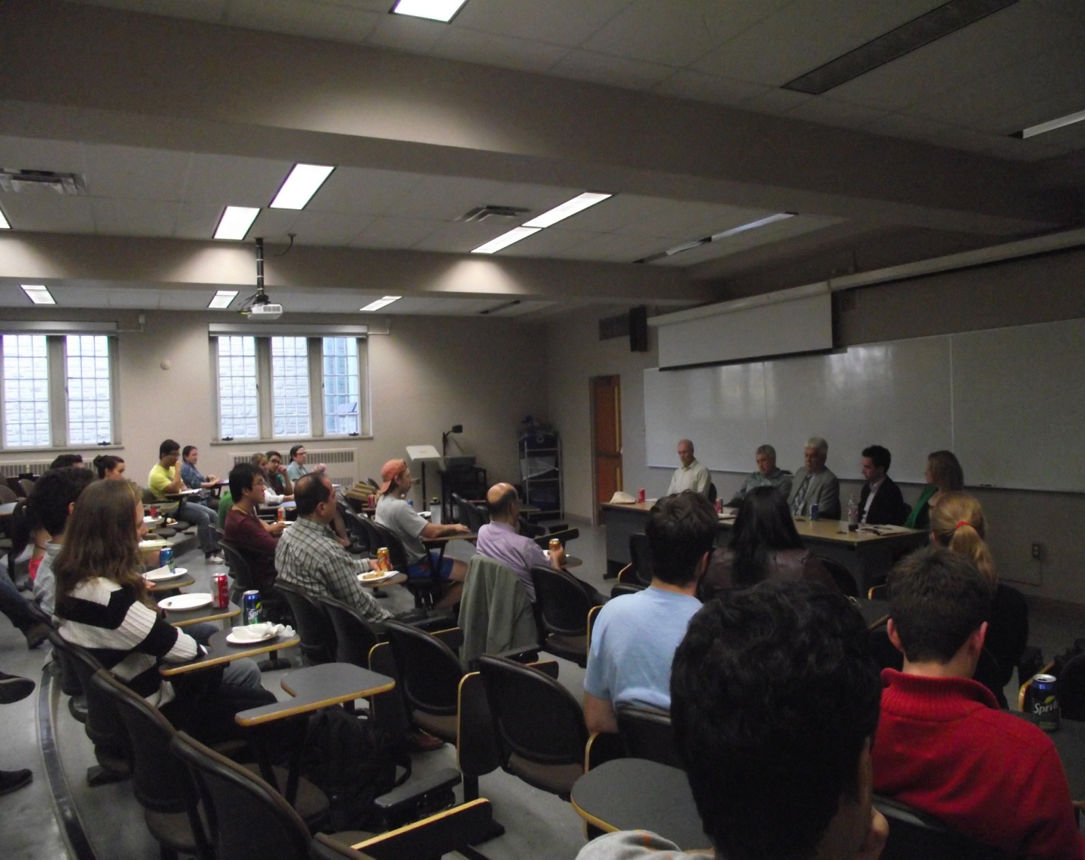
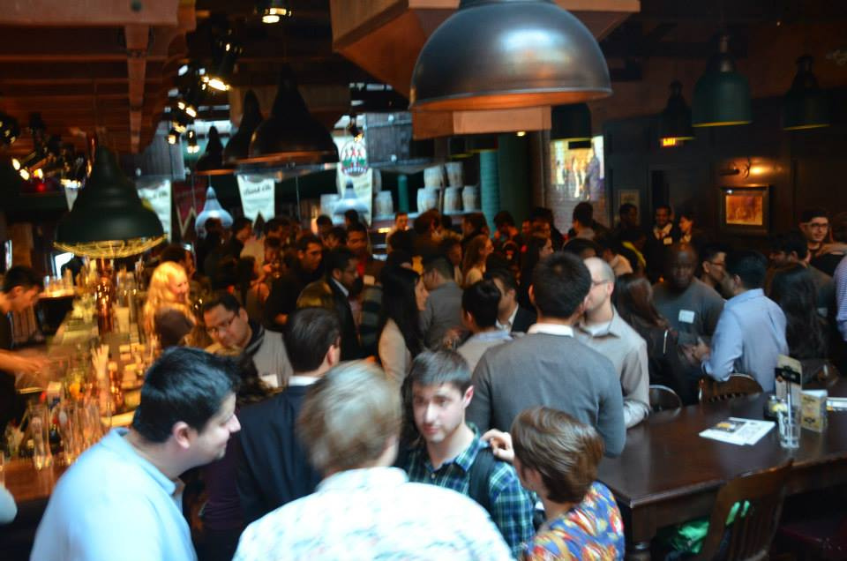
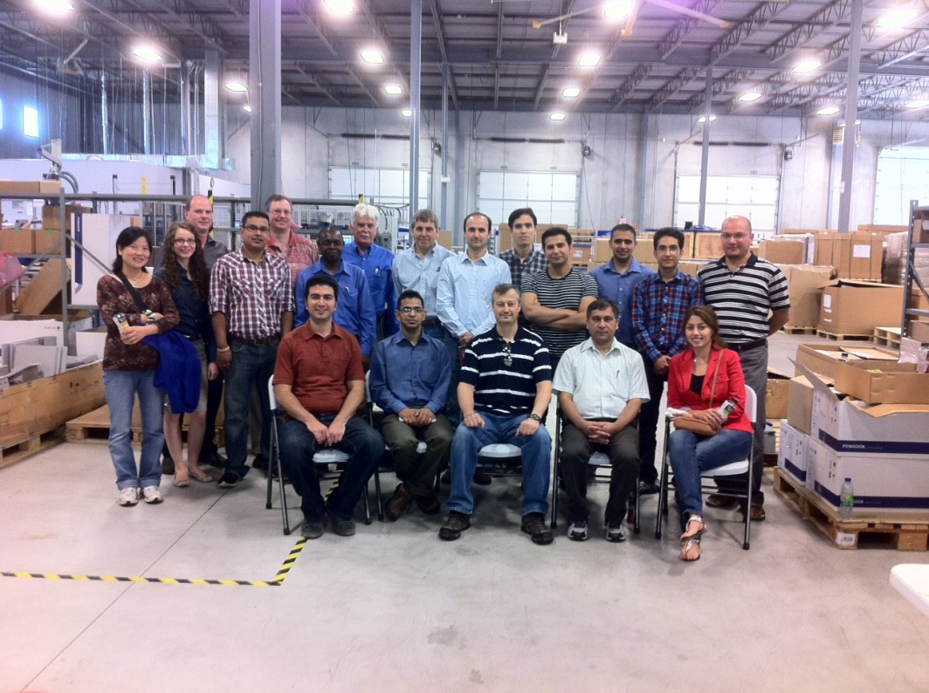
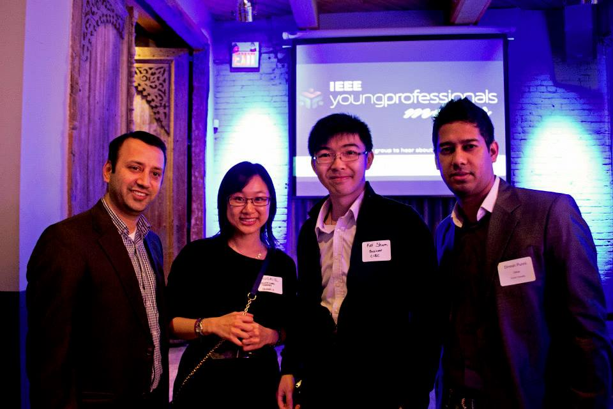
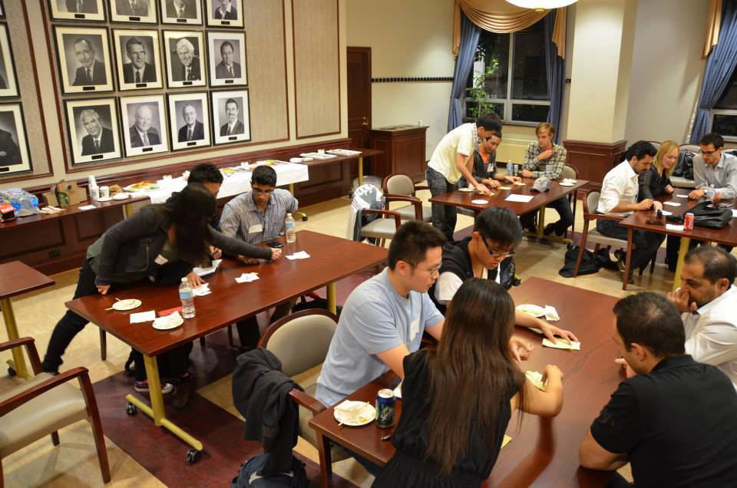
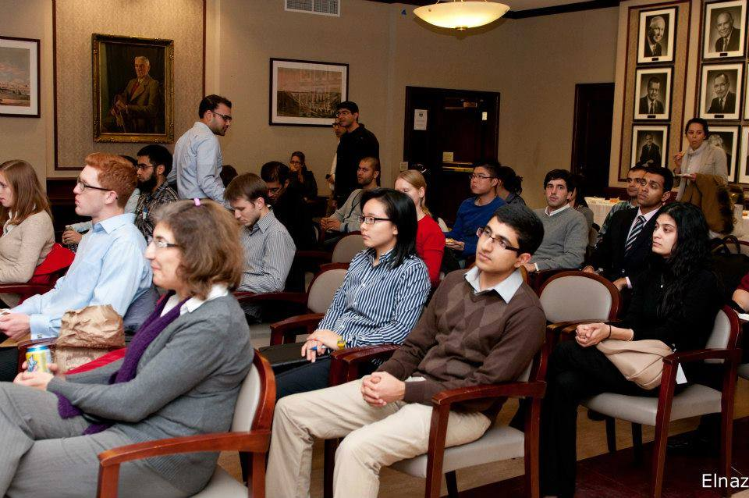
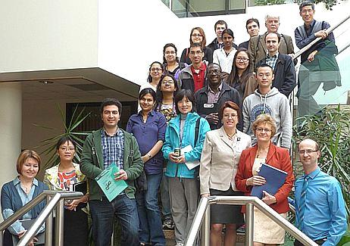
IEEE Young Professionals –London-Various Events From Last Year

Slide 7
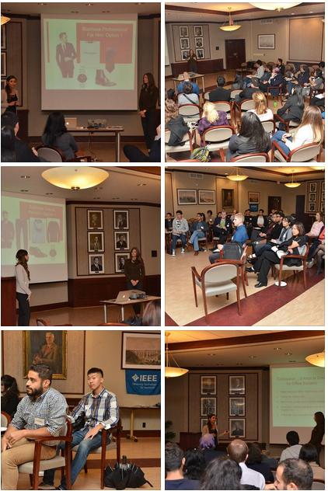
2014-2015 Events IEEE Young Professionals–Career Development Series
Our events focus on polishing the professional image and networking confidence of Students and Young Professionals
Fall 2014
1-STEP : OCT -14
2- A trip to Toronto : Oct-25
“Technical entrepreneurship mini-conference“
3- Networking mixer: Nov-28
4- Android Programming workshop : Dec-10
Spring 2015
1- “Eureka” Competition : Feb-5
2- Social event –Mar-20

Slide 8
2014 Events Technical Entrepreneurship Mini-Conference

Slide 9
IEEE Young Professionals – Various events

Slide 10
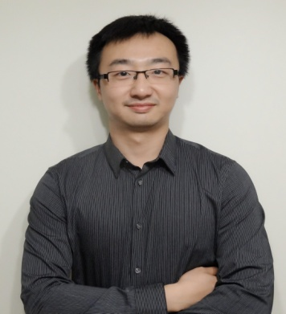
IEEE Young Professionals London Our Awesome Volunteer Team
Mohamad
AbuSharkh
Chair
Fuad
Shamieh
Vice chair
Peng
Hao
Treasurer
Mohamad
Kalil
Secretary

Slide 11
Stay Connected!
IEEE Young Professionals London
Facebook – www.facebook.com/IeeeYPLondon
http://sites.ieee.org/london
Email
mabusha@uwo.ca
fshamieh@uwo.ca
IEEE Young Professionals – Global Community
www.ieee.org/yp

